Slide 1
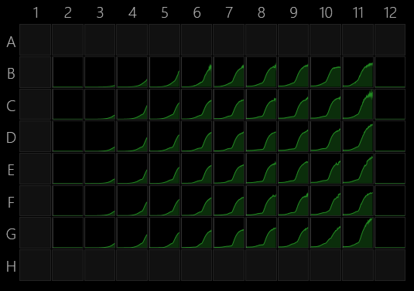
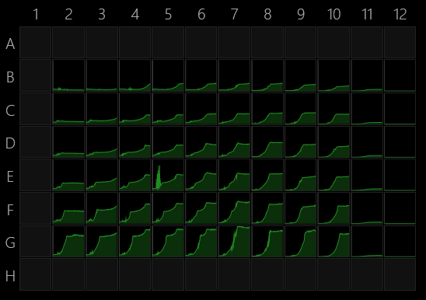
Data found in Excel file “PF-EC 4-29-22 ratios and 4HB changes”
The wells to compare are
B11 (E. coli monoculture w/ maltose only)
B2 (PF monoculture w/ maltose only)
B7 (EC:PF 1:1 coculture w/ maltose only)
RFP (E. coli)
GFP (PF)
Steady comm predictions for cross feeding
Monoculture
(Wells B11 EC and B7 PF)
Coculture (well B7)
Agar plate images maybe?

